Slide 1
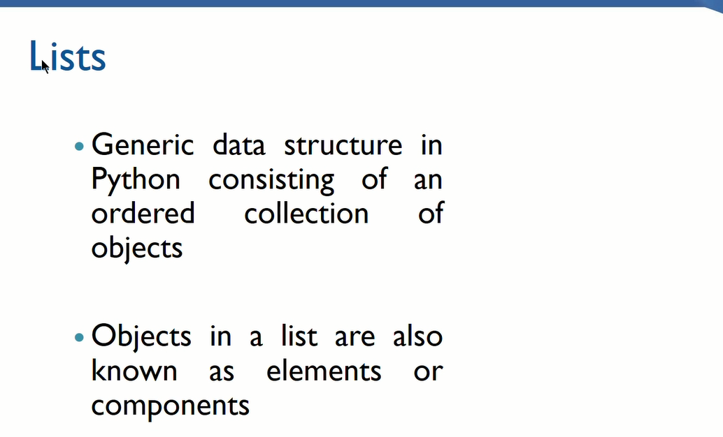

Slide 2
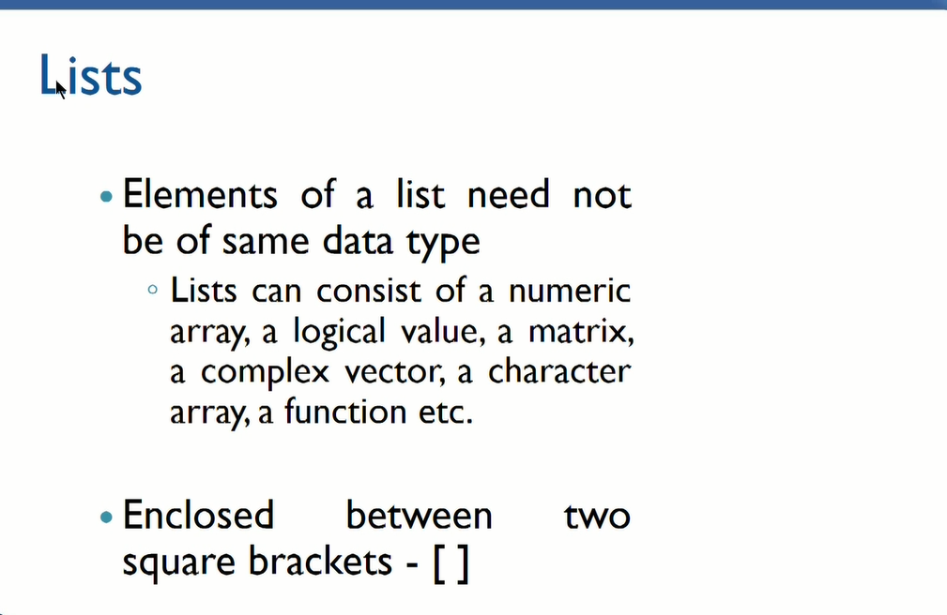

Slide 3
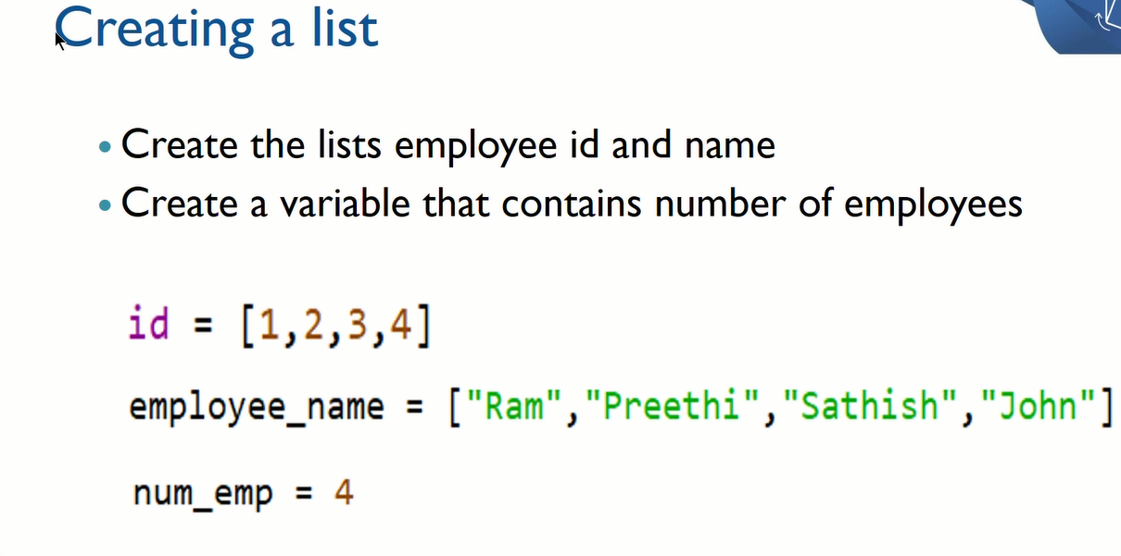

Slide 4
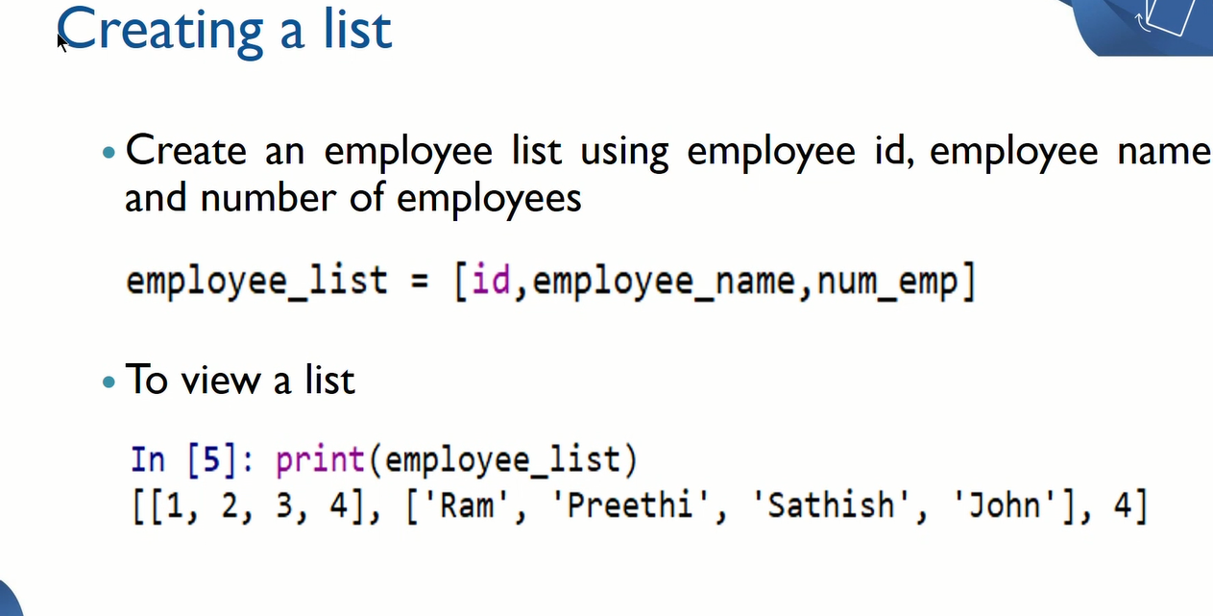

Slide 5
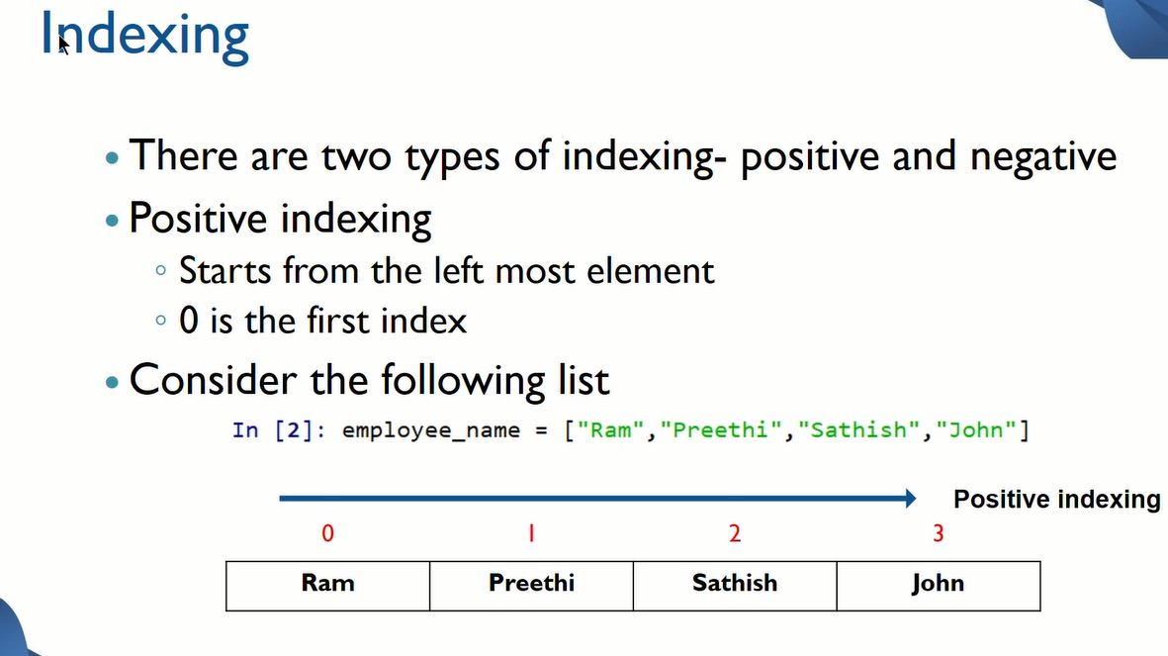

Slide 6
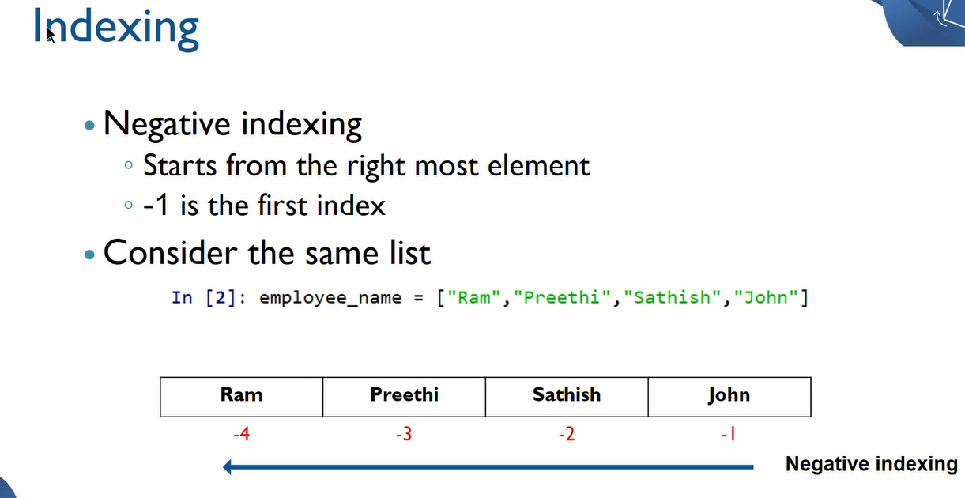

Slide 7
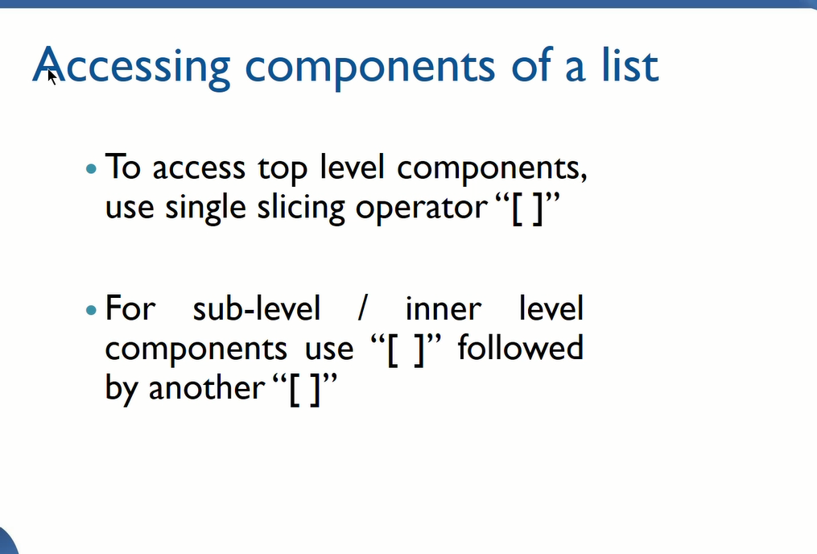

Slide 8
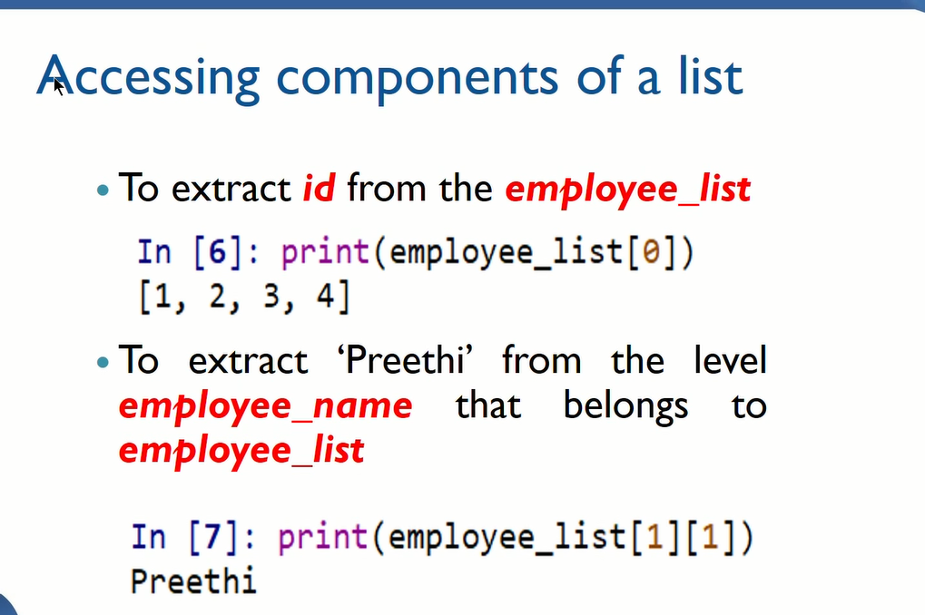

Slide 9
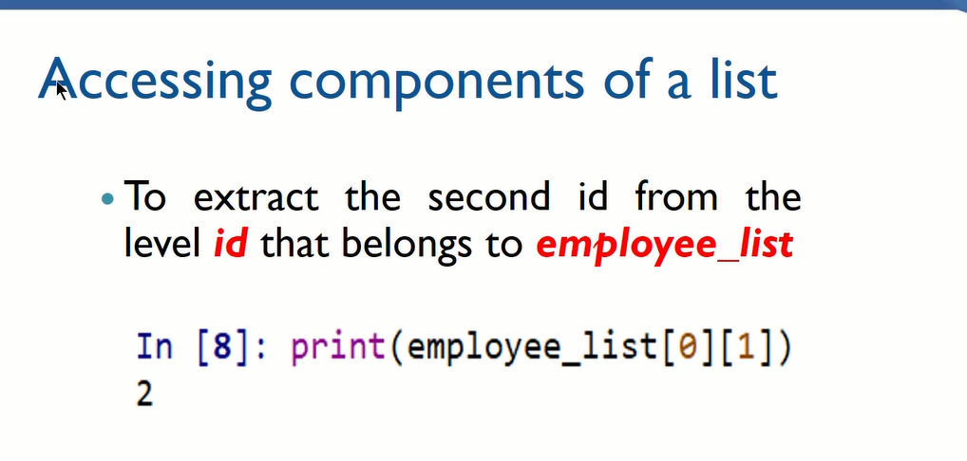

Slide 10
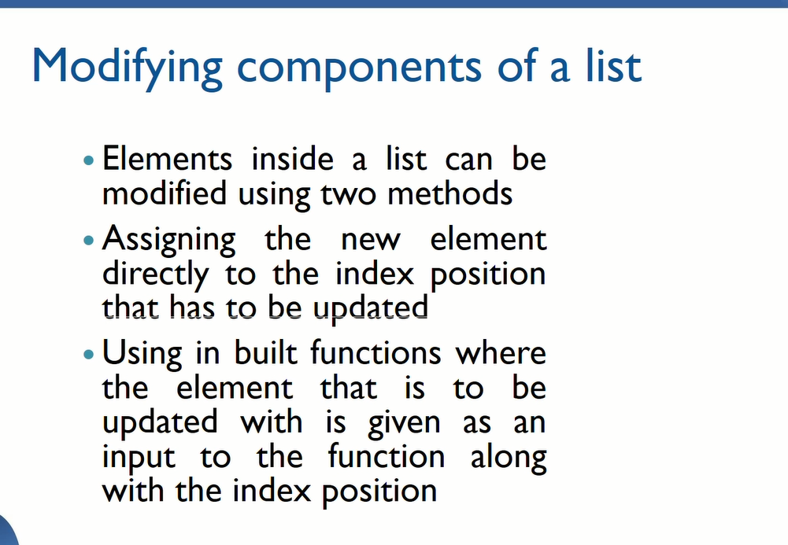

Slide 11
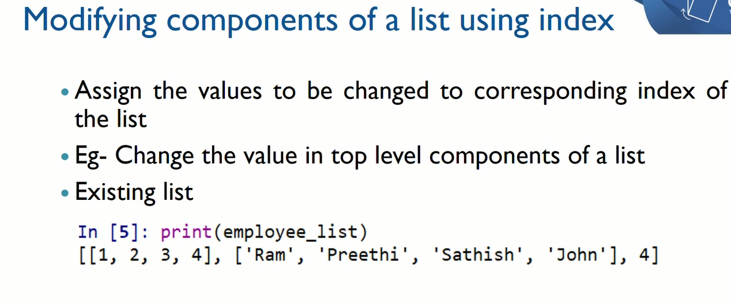

Slide 12
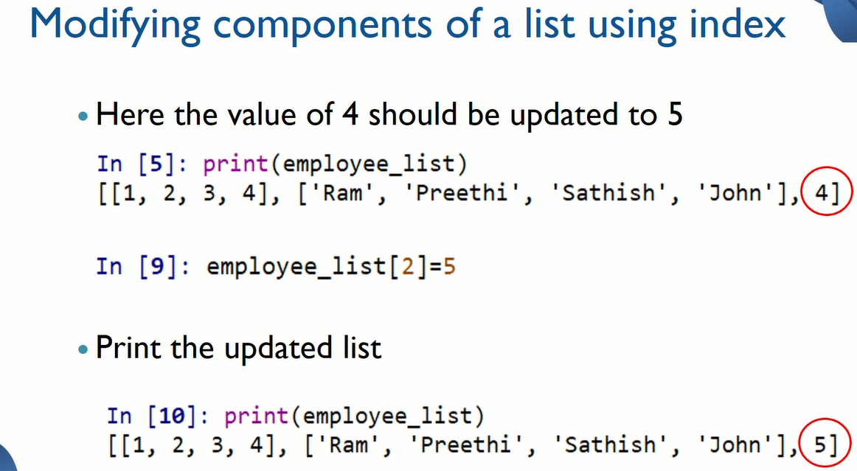

Slide 13
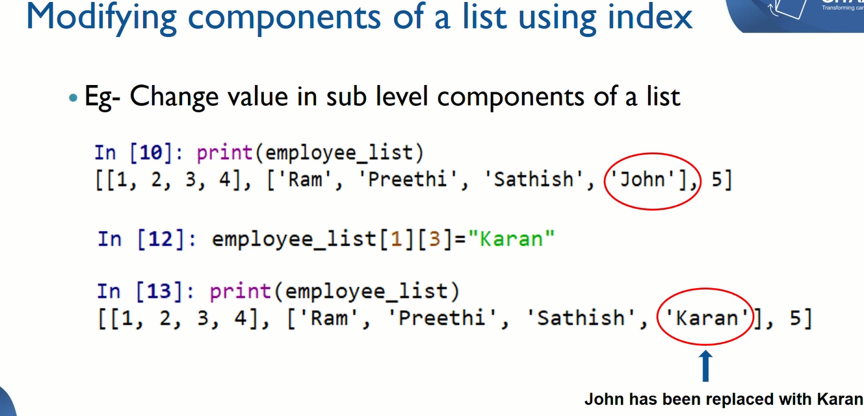

Slide 14
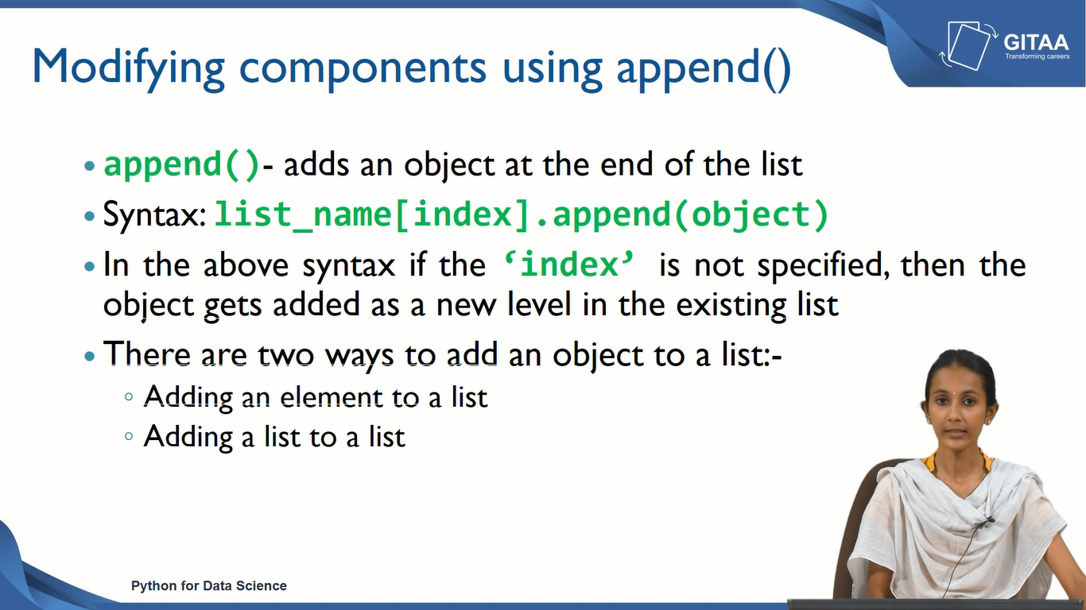

Slide 15
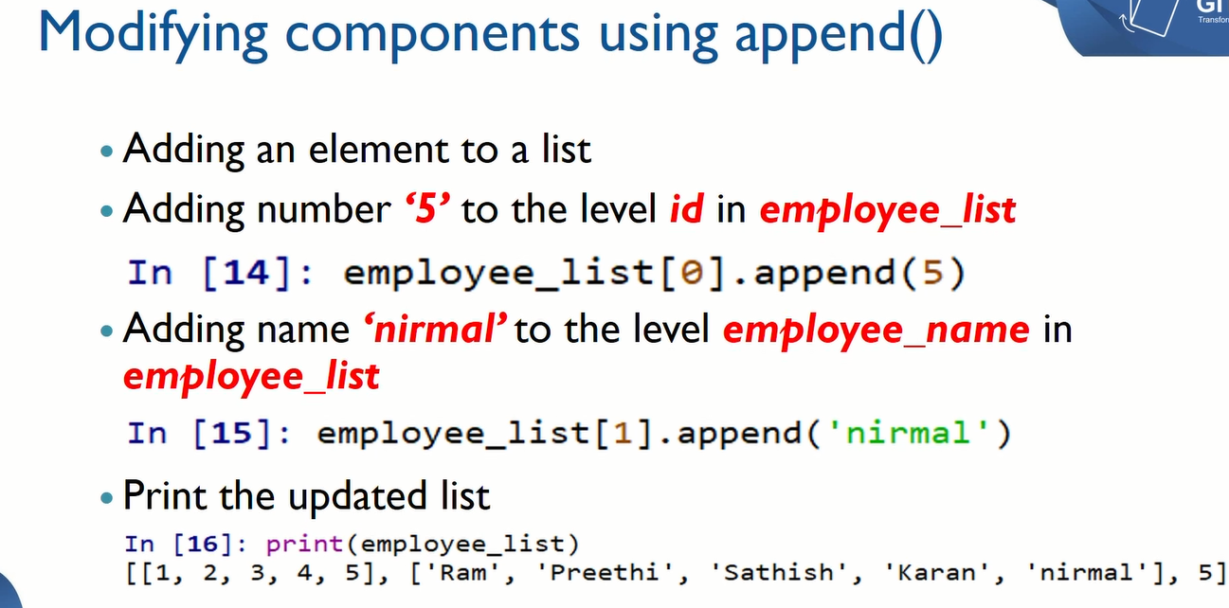

Slide 16
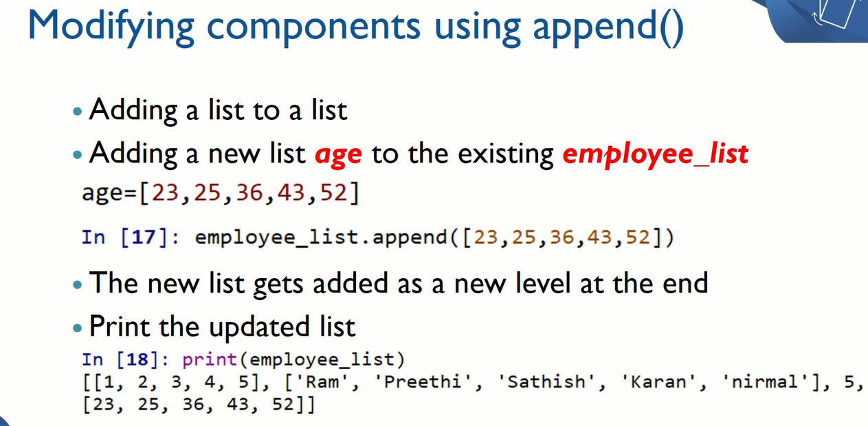

Slide 17
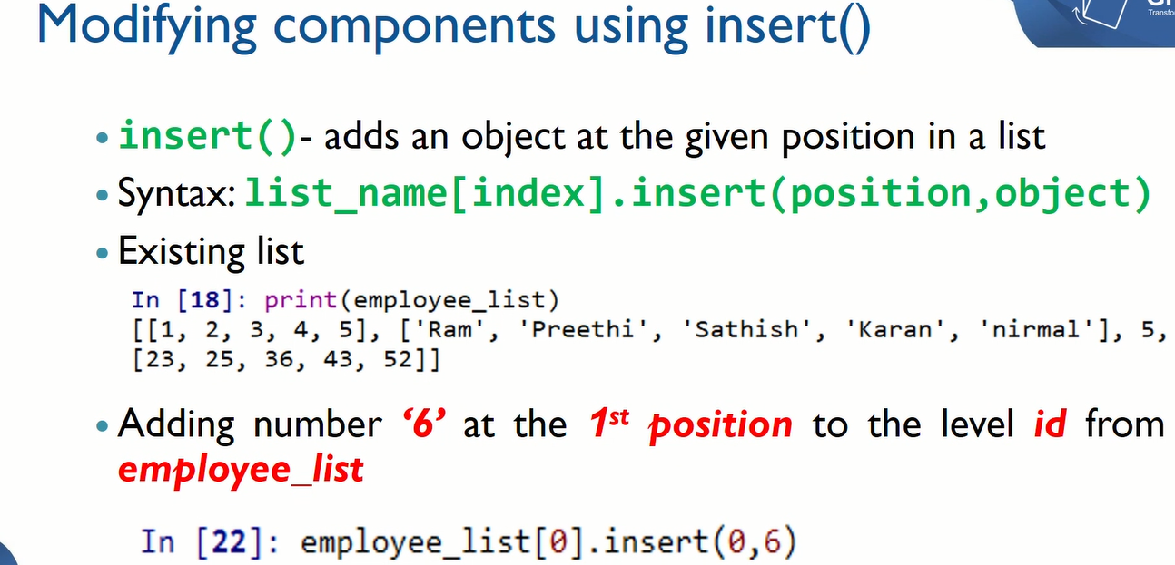

Slide 18
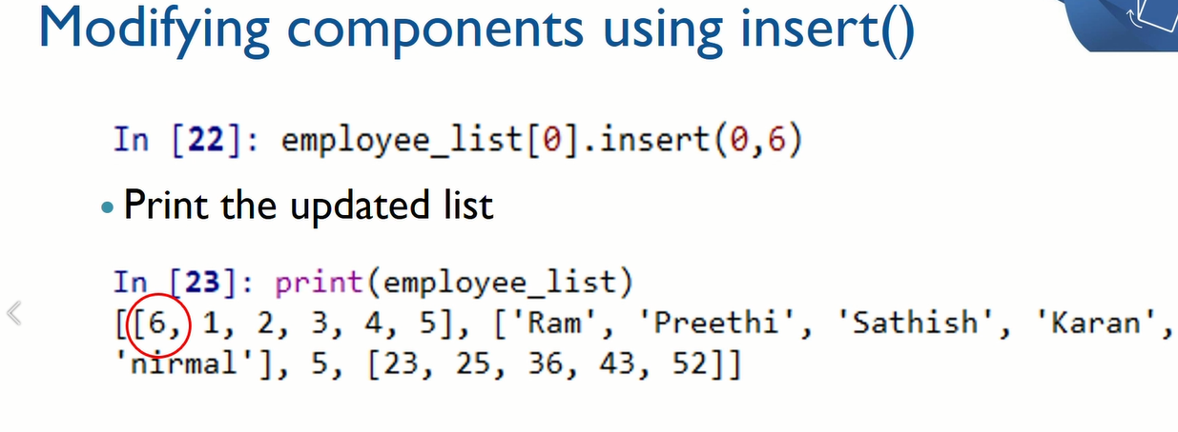

Slide 19
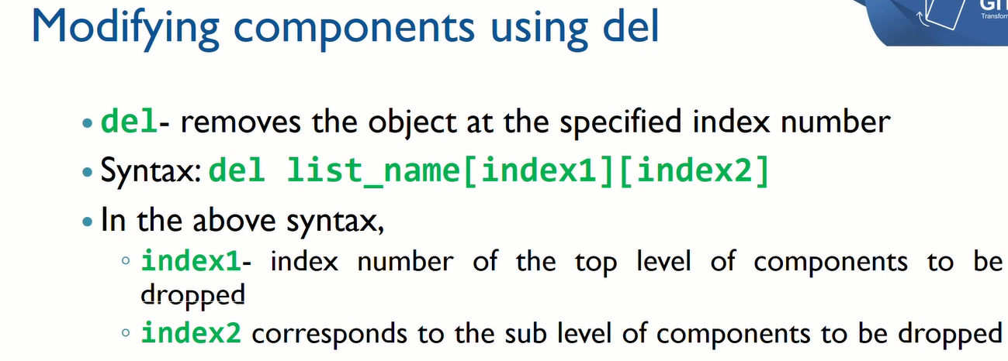

Slide 20
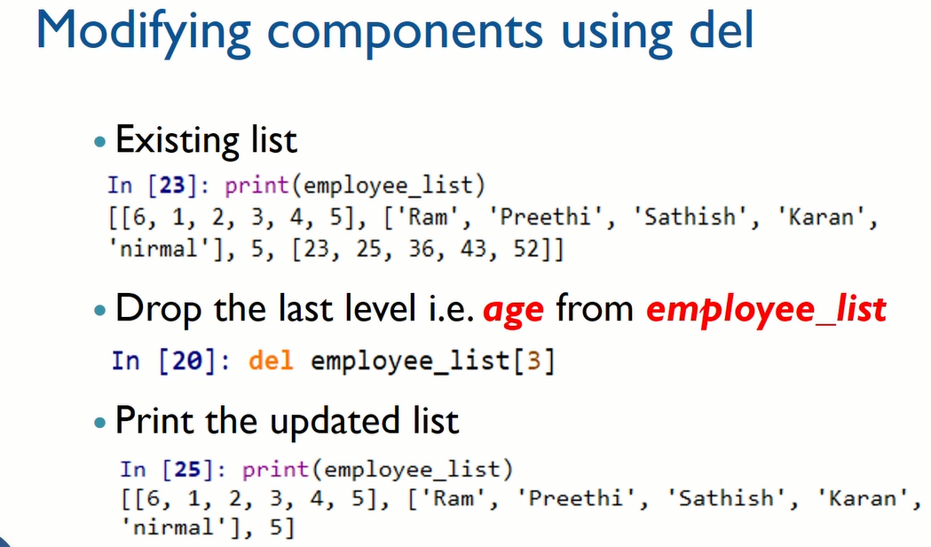

Slide 21
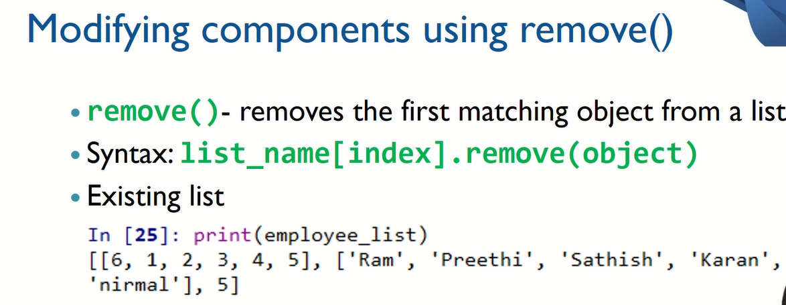

Slide 22
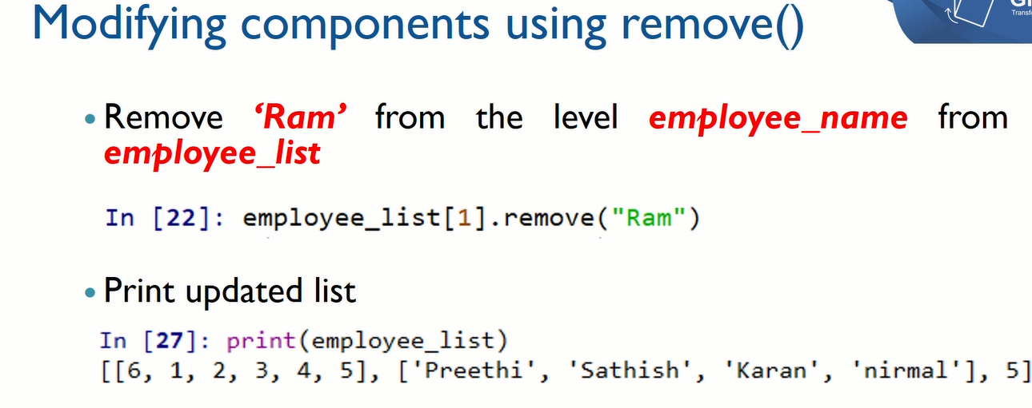

Slide 23
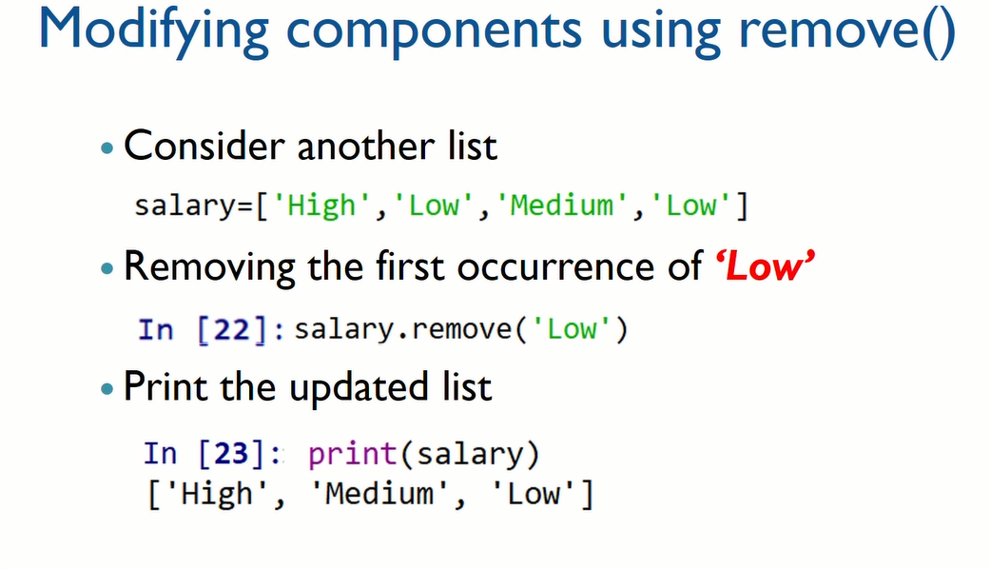

Slide 24
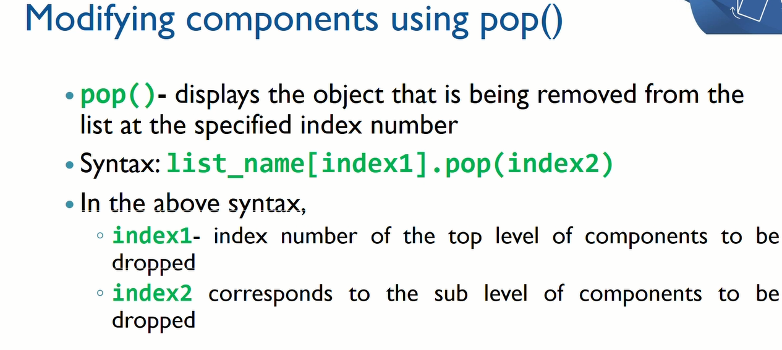

Slide 25
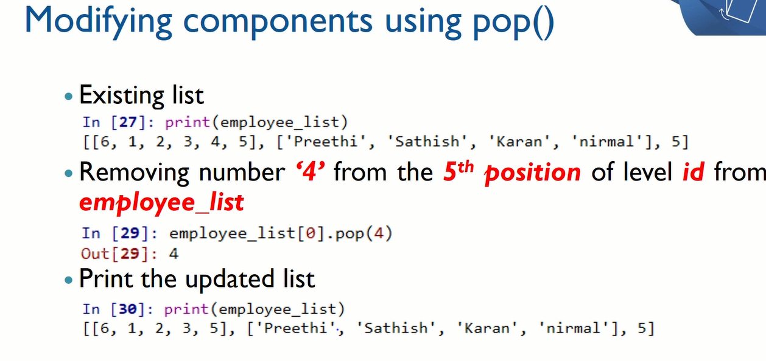

Slide 26
del | remove() | pop()
It takes the specified index and removes the value at that index. | It takes a value and removes the first occurrence of that value. | It takes index (when given, else take last) and removes the value at that index.
It limits itself to a simple deletion. | It is the only one that searches the item. | It is the only one that returns the value.
It is a prefix. | It is postfix. | It is postfix.
Syntax- del list[index] or del list | Syntax- list.remove(index) | Syntax- list.pop(index) or list.pop()
It throws an index error when the index does not exist in the list. | It throws a value error when the value does not exist in the list. | It throws an index error when an index is out of range.
del can be used for any class object. | remove is bounded to specific classes. | pop is bounded to specific classes.
del basically works on the index. | Remove basically works on the value. | pop basically works on the index.
In Python, del is a keyword. | In Python, remove() is an in-built method. | In Python, pop() is an in-built method.

Slide 27
